Slide 1

ML 101 Course
Arush Garg
AI and Machine Learning Club
Overseas Family School

Slide 2

Course (bit.ly/ML_101)
Introduction to Machine Learning (ML)
Regression
Core ML Concepts
Classification
Decision Trees
Model selection and tuning
Unstructured data: Text
Neural Networks
Unstructured data: Images
Introduction to Deep Learning
Beyond Regression & Classification
Notes:
Welcome back to ML 101 course. Today we will cover the most important ML models, i.e. Neural Networks

Slide 3

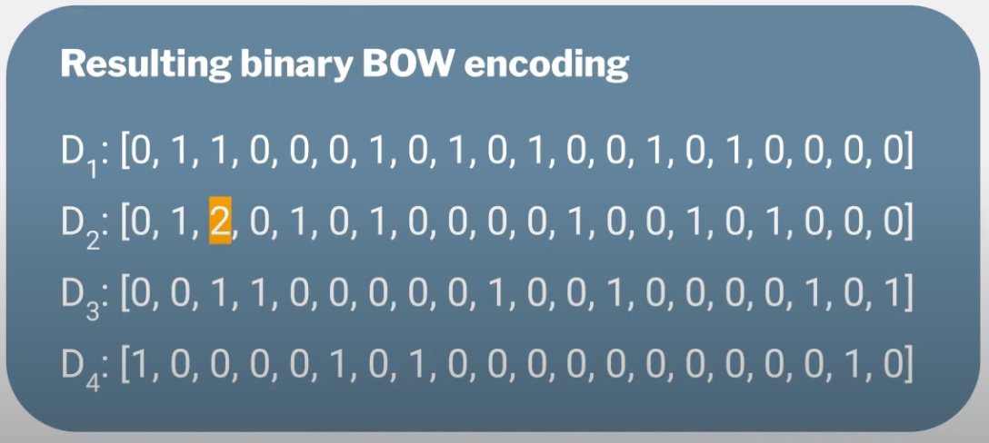
Recap
Supervised Learning
Models: Linear Regression, Logistic Regression, Decision Trees & Tree Ensembles (Random Forest) and KNN
Naive Bayes & SVM
Handling unstructured data: Text Classification
Data Cleaning: Lowercase, remove stopwords, html tags, stemming, lemmatization etc.
Tokenization: ngrams
Vectorization: Bag of Words (BOW)
Create a vocabulary based on tokens in the training data
Each text input is represented as a “present / not-present” or “count” of tokens in a fixed-length vocabulary
Vectorizes “variable length sequence of tokens” to “fixed-length numeric feature vectors”
SVM
Notes:
Quick recap. We have now covered a wide array of ML models that can be used for Supervised Learning problems. We learnt about Naive Bayes and SVM in the last lesson.
We discussed the “movie review sentiment prediction” task as a “text classification” problem. We learnt the important steps of preparing text data for model training. The most important step is the Vectorization step. This is the step that convert variable length sequence of tokens to fixed-length numeric feature vectors that can be used to train a model.

Slide 4
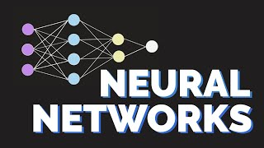
Intro to Neural Networks
Econoscent
Notes:
Now let’s learn about Neural Networks
(click)

Slide 5
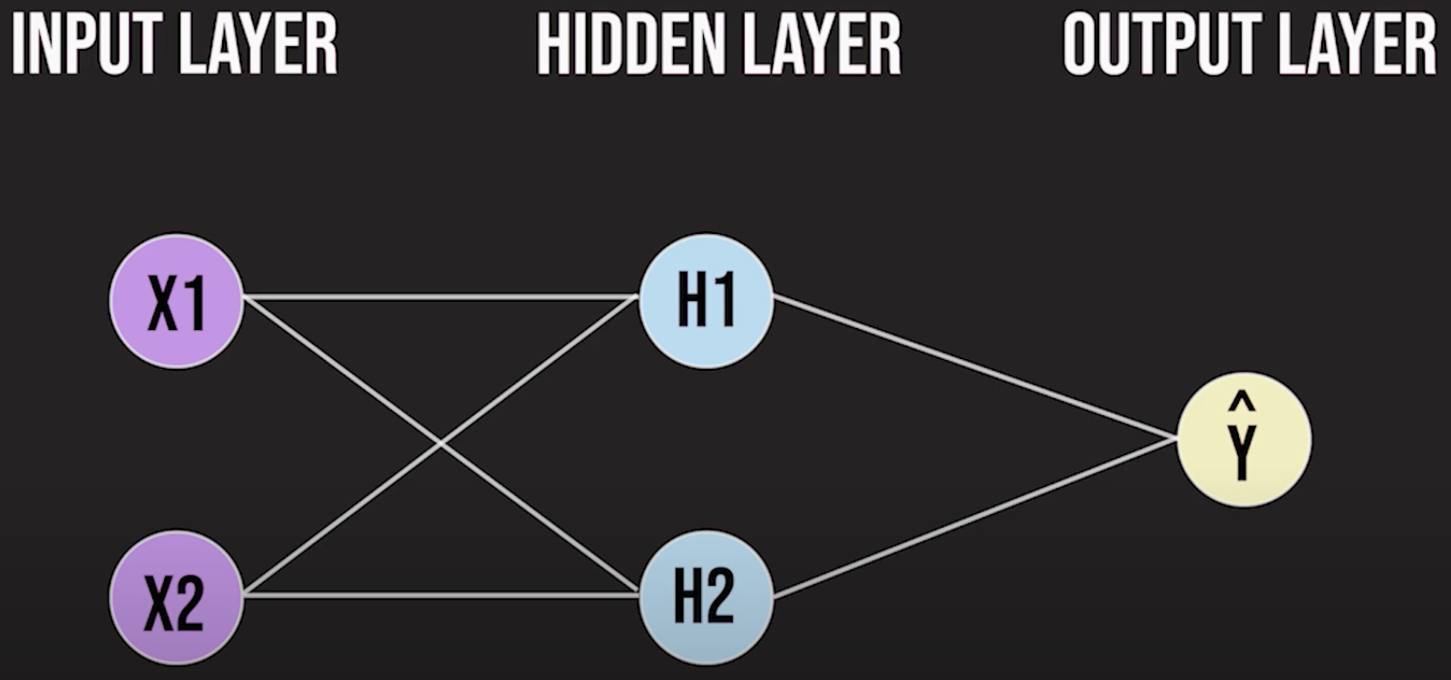
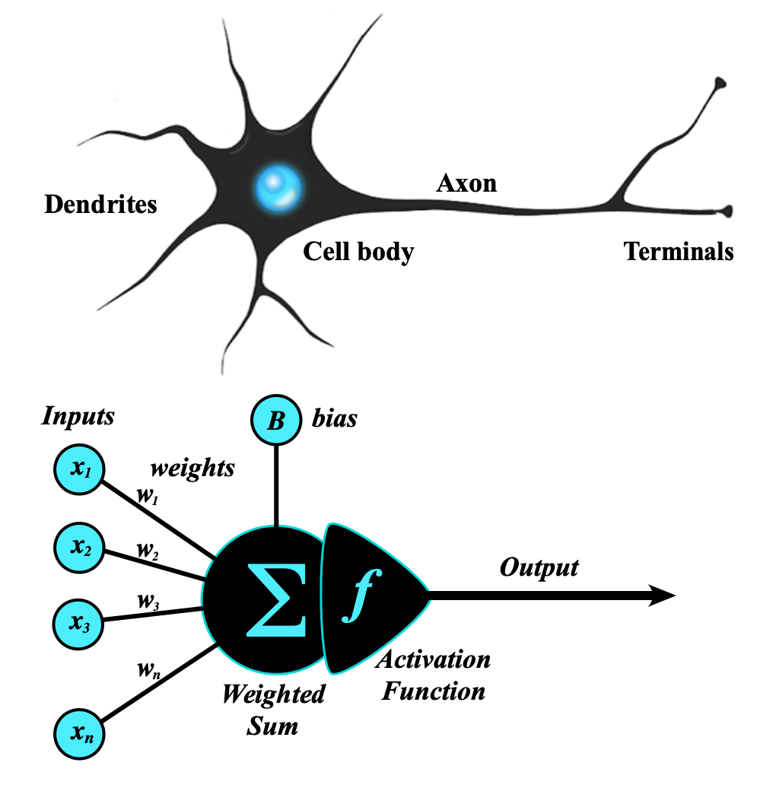

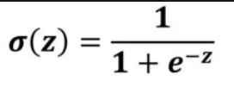
Recap: Neural Networks
Inspired by the human nervous system
Each hidden layer neuron (H1, H2) is like a tiny ML model in itself
Logistic Regression, if Activation function is Sigmoid
Each neuron in the hidden layer performs two functions
Computes the weighted sum of the inputs
Applies an activation function to introduce non-linearity
Output layer takes the outputs of the hidden layers as input, combines these inputs using a linear equation & makes final prediction.
This flow of values from “input => hidden => output” is called forward propagation.
Typically a neural network has just one hidden layer. As you add “more hidden layers”, it becomes a Deep Neural Network.
z = ∑w_{i}x_{i} + b
Notes:
To recap, Neural Networks are inspired by how human nervous system operates
NNs consist of a hidden layer of neurons such that each neuron is a tiny ML model in itself, very similar to the logistic regression model we learnt earlier.
Each neuron computes the weighted sum and applies a non-linear activation function to generate an output that is fed into the next layer. Remember, the video focused on sigmoid as the activation function, but others, like relu and tanh are also commonly used.
The output of the final layer is used as the model prediction. This flow of info from input layer to hidden layers finally reaching output layer is called “forward propagation”
Simple neural networks have a single hidden layer and a small number of hidden neurons. As the number of hidden layers increase and number of neurons per layer grow, we step into the realm of Deep Neural Networks.

Slide 6
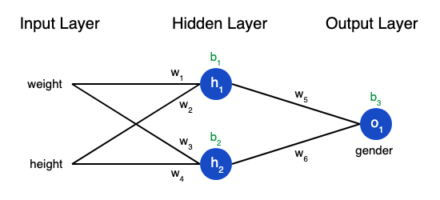
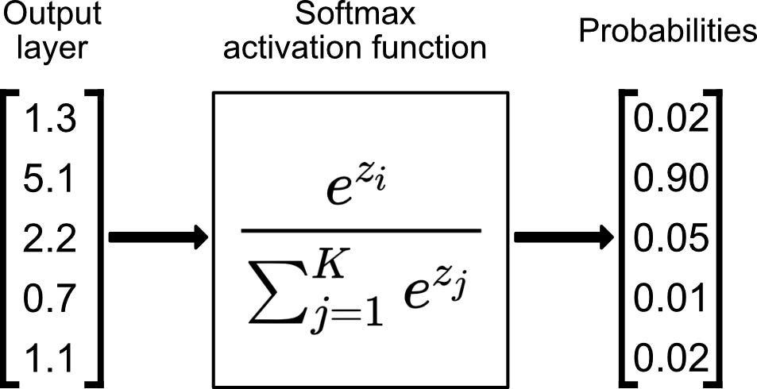
How “output layer” makes the prediction
Regression: output is the weighted sum itself, no need to apply any activation. Just like Linear Regression.
z = w₅h₁ + w_{b}h₂+ b₃
Binary Classification: we have a single output neuron that is a Logistic Regression model. That is, it uses Sigmoid activation function
MultiClass Classification:
One output neuron specific to each class
Each neuron computes its own weighted sum
All these weighted-sum outputs are fed into a single activation function called Softmax that converts these outputs to “relative probability” across all options
Class with “highest relative probability” is the final model prediction
Sum is 1.0
5 classes, therefore 5 output neurons = 5 weighted sums
Softmax equation: Maps to “relative probability”
Relative probabilities, Prediction=Class2 (max)
Notes:
In case of Regression problem, the output node simply computes the “weighted sum” of the inputs and that is used as the model prediction. Just like Linear Regression.
In case of Binary Classification, the output node acts like a Logistic Regression model and applies Sigmoid activation function to the weighted sum in order to predict class probability.
(click)
The more interesting case is “multi-class classification”. In this case the output layer has multiple neurons, one per class. E.g. in the example here, we have 5 classes hence 5 neurons in the output layer.
After each neuron computes the weighted sum, the softmax activation function is applied. Softmax activation function converts independently computed weighted-sums into relative probabilities such that the sum of probabilities is 1. The final prediction is the class with highest “relative probability”, e.g. the 2nd class with probability 0.9 in the example here.

Slide 7
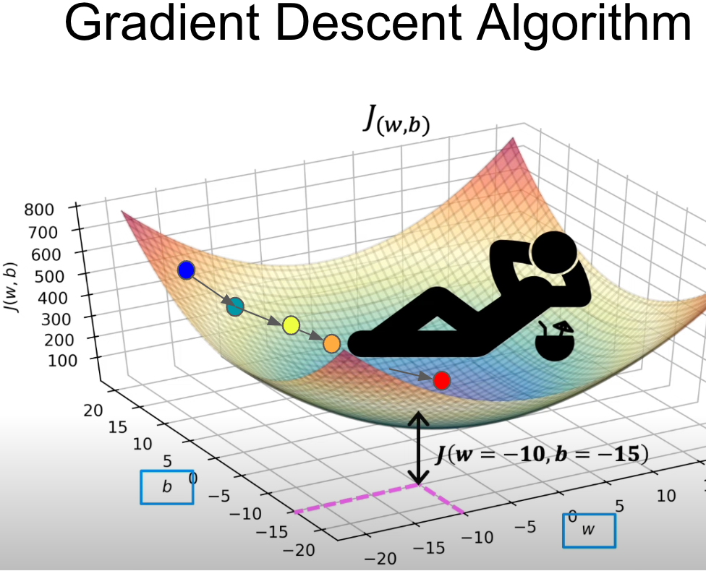
How does a NN learn? Back Propagation
Randomly initialize model parameters (weights & biases) across all connections in the neural network
Make initial prediction using “forward propagation”
Calculate “loss” / “cost” (prediction error)
Back propagation
Use Gradient Descent algorithm to update the weights of the “last hidden layer” to reduce error
As the output of “last hidden layer” is dependent on the outputs of “last-1 hidden layer”, calculate what changes need to be made to “last-1 hidden layer parameters” to reduce error.
Continue this process all the way back to update the first set of weights: connection between input layer & first hidden layer
Repeat steps 2-5 till the time model converges
Notes:
Now let’s understand how Neural Network actually learns.
Same concepts of “Cost Function” and “Gradient Descent” that we learnt in case of Logistic Regression also applies for Neural Networks.
We first initialize the model parameters randomly and use “forward propagation” to compute the output. Based on the output we calculate the cost function.
Then we use gradient descent algorithm to compute the adjustments we need to make to the weights in order to reduce the output error
Now the key difference here is that in case of Neural Network this output was produced by a sequence of computations. Hence even the error needs to be back propagated across all these layers all the way back to the first set of weights that act on input layer.
We repeat the steps of “forward propagation” to make prediction and compute cost AND “backward propagation” to adjust the weights across all layers to reduce cost till we are satisfied.

Slide 8
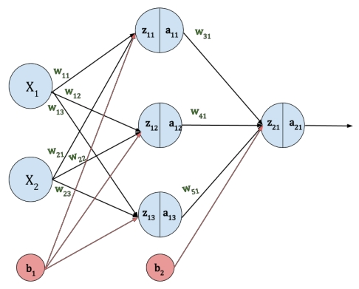
Artificial Neural Networks (ANN): Fully Connected Neural Network
Neural Networks we have discussed so far are called ANNs or fully-connected neural networks. That is, each node is connected to ALL the other nodes in the next layer with a weight parameter specific to that connection. The image on the right is an example of ANN.
Example ANN: 2 input features + 3 hidden neurons + 1 output neuron
Each hidden neuron computes one z = ∑w_{i}x_{i} + b equation
= 3*2 + 1 (bias value is common) = 7 parameters (b & w)
Each output neuron again computes one z = ∑w_{i}x_{i} + b equation
= 1*3 + 1 (bias) = 4 parameters
So total = 7 + 4 = 11 parameters to learn
As # of neurons and hidden layers increase, # of parameters grow exponentially and we step into the realm of Deep Learning.
NNs are a very flexible architecture as the neurons can be connected to each other in many different ways.
Notes:
A Neural Network where a neuron is connected to all the other neurons in the next layer is called fully-connected NN. This is what we refer to when we use the term Artificial Neural Network or ANN. Here is an example of a very simple ANN that has only 2 input features, single hidden layer with 3 neurons and single output node. Together this ANN has 11 parameters, i.e. weights and biases, to learn.
The number of parameters grow exponentially as number of neurons and number of hidden layers increase. Once this number is huge, say million plus, we enter the realm of Deep Learning.
The power of NNs lie in the flexibility it provides. We can create many different architectures as we will see in the subsequent lessons.

Slide 9

Hands-on Exercises
Lesson 8 / Neural_TextClassification.ipynb
https://bit.ly/ML_101
Notes:
The problem for this lesson’s hands-on exercise is the same: Identifying whether a review is positive or negative. We will use neural networks to tackle this problem, and compare their performance to SVM and Random Forest, the models used last lesson.

Slide 10
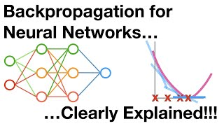

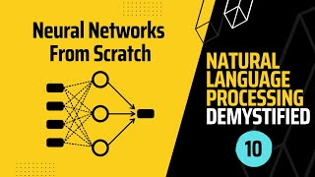
Further Reading / Watching / Doing
Neural_SpamFilter.ipynb
https://bit.ly/ML_101
Backpropagation
Future Mojo - Playlist of NLP
Notes:
To try using neural networks for another problem, check out this lesson’s problem.md file. It looks at the same spam filtration problem, but with neural networks this time.
You can also watch these videos to learn more about Backward Propagation and the use of Neural Networks for Text-related problems.

Slide 11
Agenda for next class
Unstructured Data: Images
MNIST dataset
Multi-class Image classification
Limitations of ANN for Image Classification
CNNs (Convolutional Neural Networks)
Deep Neural Networks that are commonly used for Computer Vision problems
Convolution and Pooling layers
Notes:
Now we are done covering all Supervised Learning algorithms
We have also seen how we apply ML for unstructured text data
In next class we will learn how to apply ML algorithms for images. We will understand the limitations ANN poses for Computer Vision problems. And we will learn about CNNs, the most commonly used Deep Learning algorithms for ML tasks involving images.

